Slide 1
Updates in Stroke and Neuro Rehab
Darryl Kaelin, MD, FAAPMR
Professor and Chief of Physical Medicine and Rehabilitation
University of Louisville
Medical Director of Frazier Rehab Institute
8/23/2019

Slide 2
Stroke Demographics
800,000 strokes in the US annually
Between 2000 and 2010 stroke deaths dropped 35.8%
Still only a minority of stroke survivors get TPA
2/3 of stroke survivors receive some type of rehabilitation services
Average acute hospital LOS = 4 days
AHA/ASA Guidelines support interdisciplinary rehab program typically lead by a physiatrist (PM&R).
Still as much as 42% of stroke survivors receive no post-acute services

Slide 3
Post- Acute Care vs Acute Care
Acute Care is considered episodic even when treating a chronic condition repeatedly
Post-Acute Care includes:
Long Term Acute Care Hospital (LTACH) – 400+ providers
Acute Inpatient Rehab Facility (IRF) – 1200+ providers
Skilled Nursing Unit/Facility ( SNU/SNF) – 15,000+ providers
Home Health Agency (HHA) – 12,000+ providers
Outpatient Therapy Services
New IMPACT Tool will measure outcomes across all of these settings and likely lead to a unified payment structure

Slide 4
Post-Acute Care
Post-Acute Care constitutes 71% of the variance in health care expenditure
36%-43% of acute hospitalized patients are discharged to a PAC setting
38% Home Health
51% Skilled Nursing Unit/Facility
9% Acute Inpatient Rehab Facility
2% Long Term Acute Care Facility
Many others are discharged home and receive outpatient therapy services
On average pts discharge to PAC setting pass through 2.7 PAC settings

Slide 5
Stroke Rehabilitation
Barthel Index and FIM are good predictors acutely for:
Discharge functional status
Discharge destination after inpatient rehab
Rehabilitation LOS
Currently there is no single assessment tool used throughout the continuum of stroke care (Acute hospital -> IRF/SNF -> HH/Outpt)
FIM (1-7: dependent -> independent) has been our best tool historically but CMS is moving to IMPACT Tool for all setings in October 2019.

Slide 6
Inpatient Stroke Rehabilitation
Acute Inpatient Rehab Facility (IRF)
1200 IRFs in the US
380,000 IRF admissions (20-25% strokes, 60% rule). All require a PA.
Average LOS = 14 days
+/- 80% go home, 10% RTH, 10% go to SNF
Must be medically stable and able to tolerate and benefit from at least 2 disciplines for 3+ hours/day 5 days/week with an expectation they will go home
Must be seen by a rehab physician at least 3 days/week (often daily)
Paid for on a PPS payment system based on diagnosis, severity and comorbidities (ex. 14 day stay for 14,000.00). All facility cost come out of payment

Slide 7
Inpatient Stroke Rehabilitation
Skilled Nursing Unit/Facility (SNU/SNF)
15,000 SNFs (11% of LTC facility days but 19% of revenues)
2.3 million admissions (1/5 of acute hospital discharges, no Medicare PAs needed)
Average LOS = 26 – 38 days (avg payment of 480.00/day)
Payment on a per diem based on number on minutes of therapy received
10/1/19 – New CMS PPS will be based on pt characteristics, not therapy alone
Based on this model SNFs will likely deny patients with more heavy therapy needs and complex medical problems leaving these to go to IRFs or LTACHs.

Slide 8
Why am I telling you this?
Move from a fee for service model to a value based alternative payment model
Value = Outcome / Cost
PCPs and hospitalists MUST begin to focus on prevention (ie. Population Health) and controlling the care provided in the PAC continuum
This is where PM&R/Physiatry fits in to manage those resources and drive outcome up while keeping cost down (Value)
In other words I am setting the stage to discuss the care of acute neurological patients

Slide 9
Prevention of early Co-Morbidities
Skin breakdown – q 2hour turning. Appropriate bed/mattress
DVT Prophylaxis – oral anticoagulant and LMWH > Standard Heparin
Spasticity – often goes unrecognized by caregiver or PCP (35-45%)
Oral meds – Dantrium, Tizanidine, Baclofen, Gabapentin
Botulinum Toxins
Intrathecal Baclofen Pumps
Surgical tendon lengthening or transfers
Contracture – 60% of those w/ HP develop contracture w/in 1 year
Resting splints or casts
AFOs
Hemiplegic shoulder pain – humeral cuff sling, ROM, e-stim, injections

Slide 10
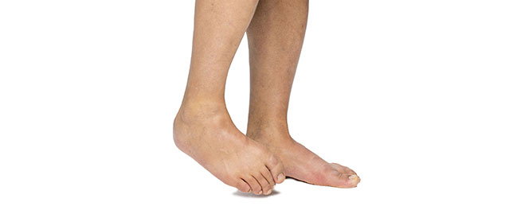
Spastic Arm and Leg after UMN Disease

Slide 11
Prevention of Co-Morbidities
Depression – Negative impact of functional recovery
Acutely – L CVA (organic)
Delayed – R CVA (reactive)
Treatment – SSRIs and possibly short term stimulant use
FLAME Trial – SSRIs (Fluoxetine) improved motor recovery and subsequently may also improve mood (2ndary outcome)
Exercise – Especially in groups improved mood and cognition, functional recovery and reduced rehospitalization
Osteoporosis – Increased risk of lower BMD with paresis and sedentary lifestyle. Can be corrected with activity and medication

Slide 12
Secondary Stroke Prevention
Lifetime stroke recurrence rate = 30% (24% women and 42% men)
Smoking Cessation – An absolute must
Hypertension – (75%) <140/90 and probably <130
Hyperlipidemia – (56%) LDL-C level <100
Diabetes – (24%) lower HbA1c
Ischemic heart Disease – (37%) Nutritional counseling, Na+ < 2.4gm/day
Atrial Fibrillation – (29%) Oral anticoagulants
Screening – Appropriate screening for OSA and carotid disease

Slide 13
Exercise after Stroke
Activity level after stroke is an independent predictor of life satisfaction
CVA survivors have compromised cardiorespiratory fitness (< 53%) compared to age matched normal
Stroke survivors ambulate 50% less than age matched normal
Exercise programs that improve VO2 max reduce rehospitalization and improve 1-2 year survival rates 10-25%
Improves cognition, bone density, fall risk, mood and QoL
Reduces weight, cholesterol, and resting BP. Improves Glucose tolerance

Slide 14
Simple Primary Care and Neurology approach to stroke outpatient assessment:
Ask pt/caregiver about FUNCTION – mobility and self-care assistance and DME use
Ask about or use Quality of Life measure
Ask about mood (depression and/or anxiety)
Assess vision, hearing, taste and smell, and swallowing
Assess basic cognition (MMSE)
Ask about pain
Ask about compliance with secondary stroke prevention
Ask about caregiver burn-out

Slide 15
Simple Primary Care and Neurology approach to stroke patient assessment:
In addition to standard medical examination make sure to:
Check Skin for breakdown (elbows, feet, buttocks, groin)
Check for spasticity and ROM
Examine strength and sensation (especially proprioception in feet)
Examine gait or at least stand patient
Determine need for:
Therapy (PT, OT, SLP, psychology)
PM&R consultation – Therapy Rx, Equipment Rx, Assistive Technology, Spasticity tx, cognition
Osteoporosis assessment
DME order – cane, walker, wheelchair, bathroom equipment
Other specialty referrals – Ortho, Endocrinology, Cardiology, Hematology

Slide 16
Drugs for Cognitive Impairment
Methylphenidate –
Helps with initiation and arousal in early post stroke period.
May help short term with some depressive symptoms until SSRIs kick in
Achesterace Inhibiters –
Donepizil – Showed cognitive improvement (MMSE) mostly frontal lobe fxn
Rivastigmine – Improvement in Verbal Fluency but not attention
Fluoxetine – Improvement in executive fxns 21 months after CVA vs placebo independent from depressive symptoms
Amantadine/Memantine – Theoretically may help early after CVA to reduce apoptosis by NMDA receptor antagonism

Slide 17
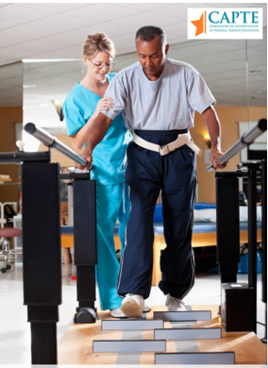
Rehab Technology ( Gait )
Almost all therapy that challenges the nervous system and generates neuroplasticity is beneficial compared to placebo.

Slide 18
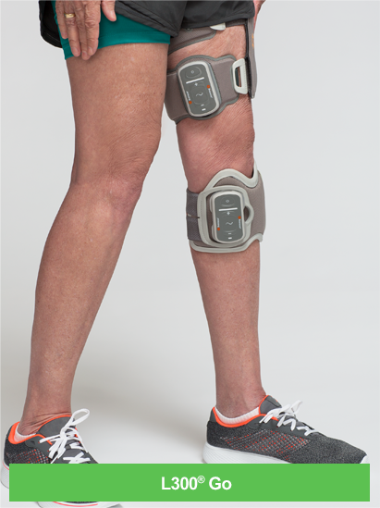
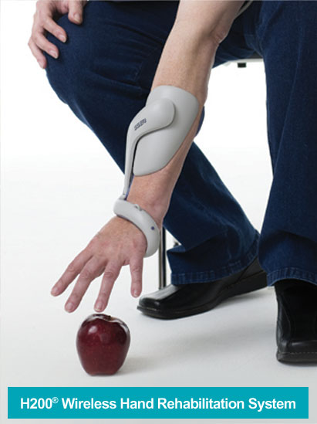
Rehab Technology
E-stim may be helpful when added to task specific activity

Slide 19
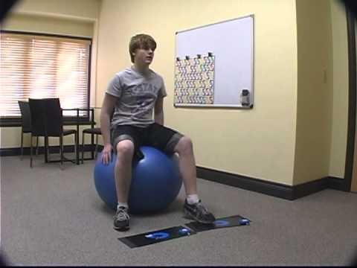
Rehab Technology ( Gait )
Rhythmic Auditory Cuing / Metronome Therapy – may increase gait velocity and balance

Slide 20
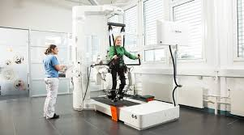
Rehab Technology ( Gait )
Robotic Gait Training – 2013 Cochrane review showed stroke survivors receiving robotic gait training w/in 3 mo. after stroke were more likely to reach independent ambulation
Virtual Reality – Adding virtual reality to leg activities improves movement and gait parameters and speed

Slide 21
Rehab Technology ( Arm Activity )
Constraint Induced Movement Therapy ( CIMT)
Improves upper limb activity, participation and QoL in CIMT pts vs traditional
1-3 hours/day 3-5x/week x 2-10 weeks
NMES – does not improve strength if done alone w/out activity
Must be added to task specific activity
Can reduce shoulder subluxation

Slide 22
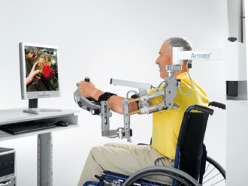
Rehab Technology (Arm Activity)
UE Robotic Therapy – Increased repetition
2012 Cochrane Review: Improved ADLs and arm fxn but not strength when compared to traditional tx but not dose matched therapy

Slide 23
Return to Driving
Kentucky encourages but does not mandate reporting individuals with cognitive or medical conditions that would impair driving to the DMV.
If suspected as unsafe to drive encourage patient to…
Complete DMV medical form and have a road test performed free of charge by local DMV
Perform formal driving assessment by a state licensed disabled driving evaluator ($250 - 300.00)
If unsure then many hospital based rehab oupt programs have an OT that can do pre-driving assessments to check basic cognition, vision, and reaction time.

Slide 24
Return to Work
Less than 50% of stroke survivors that were working at the time of stroke RTW by 1 year
Often the process goes from independent at home to driving to RTW
Most will need interdisciplinary rehab ( PT, OT, Speech Therapy)
Consider Vocational Rehab Counseling for support
Job Assessment
Job Coaching
ADA – “Reasonable Accommodations” through modifications
Job Retraining

Slide 25
Take Aways
Too many stroke survivors go without needed rehab services
Many of those patients would benefit from Physiatry consultation and interdisciplinary care
The right care at the right time will improve outcomes and control costs which will help your health care network
You must learn the differences in stroke resources in and around your community (Acute -> LTACH -> IRF -> SNF -> HH -> Outpt Therapy)

Slide 26
Take Aways
You must recognize and prevent/treat the common co-morbidities of stroke
You must standardize your outpt stroke follow up exams
You must reinforce secondary stroke prophylaxis measures w/ pt/caregiver including meds, nutrition, exercise and f/u visits
Return to higher function, independence, RTD and RTW is possible

Slide 27
Questions?

