Slide 1
Back to Basics with Back Pain-An Overview
Narendra Nathoo, M.D.; Ph.D.; F.C.S.; F.R.C.S.(C); F.A.C.S.; F.A.A.N.S
Staff Neurosurgeon
The Medical Center
Bowling Green
Kentucky

Slide 2
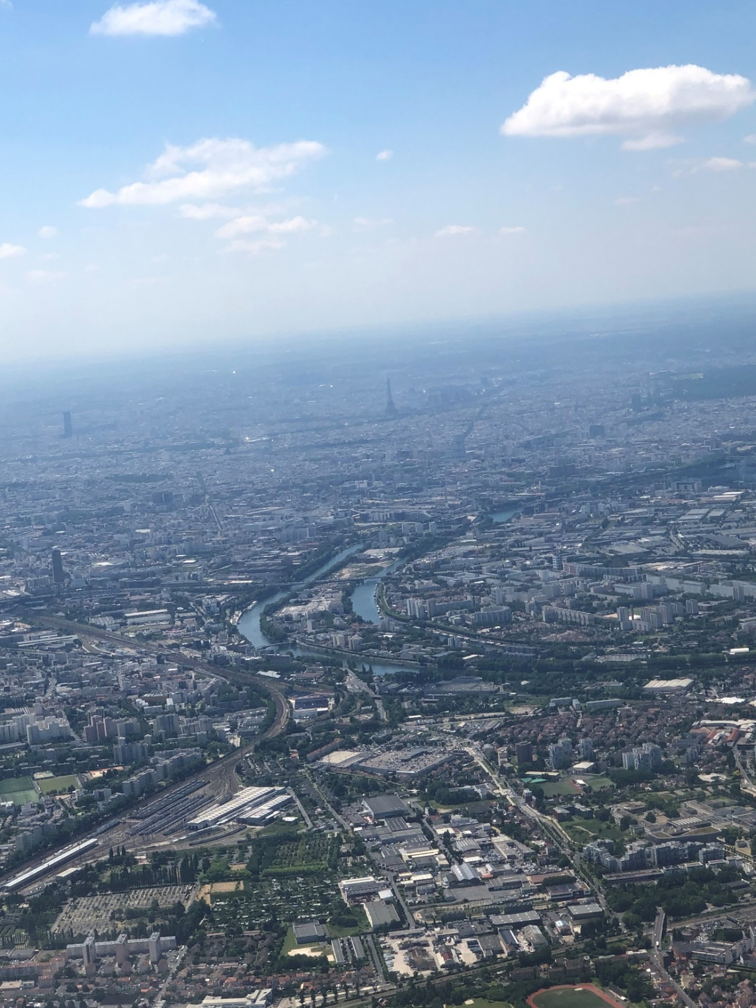
Basics of Spine
Outline:
Anatomy
Pathophysiology
Pathology
Clinical Presentation (signs and symptoms)
Common spinal conditions
MIS spine surgery
Excluded –spinal fractures, Acute spinal cord injury, cord syndrome

Slide 3
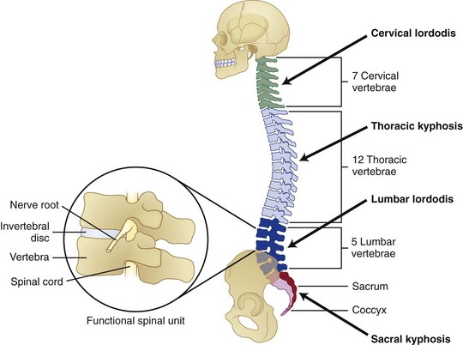
Anatomy
“Bridge in motion”
The functional spinal unit
Nerve roots –Radiculopathy
Spinal Cord –Myelopathy
Ending of spinal cord (adult vs. child)
CSF
Vertebrae (n=33) Cervical =7; Thoracic =12; Lumbar =5; Sacral=5; Coccyx = 4
Nerve roots (n=31) Cervical =8; Thoracic =12; Lumbar =5; Sacral=5; Coccyx = 1

Slide 4
Spinal Curves
Babies - Fetal position (single primary curve)
Adults- secondary curves (lordosis)-
S shape spine –acts like a spring
Resulting in improved distribution of weight in erect position
Curves keep body’s center of gravity over the hips and pelvis

Slide 5
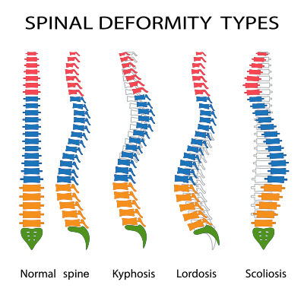
Spinal Curves
Normal spine –viewed from side (sagittal plane) has physiological curves (impaired sagittal balance
Normal spine –viewed from front (coronal plane ) straight – abnormal scoliosis
Abnormal Spinal Curves:
Scoliosis
Kyphosis
Kyphoscoliosis
Other regional/global abnormalities:
Exaggerated lumbar lordosis
Impaired sagittal balance

Slide 6
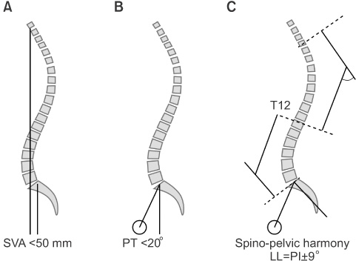
Global Sagittal Alignment/Sagittal Balance
Ideal Spinal Alignment
SVA increases with age
Sagittal deformity SVA ± 5 cm from posterior corner of S1

Slide 7
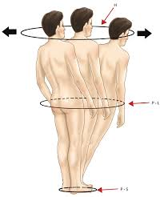
Concept of Sagittal Balance
Spinopelvic balance – in sagittal plane –open linear chain linking head to pelvis (erect posture –head-torso-pelvis with in distance)
Dubousset Cone of Economy important in:
Maintaining up right posture
Minimizes energy with standing /walking
Increasing positive sagittal balance causes:
-position towards periphery of cone
-increased muscular effort/energy expenditure
-causes pain, fatigue, disability
If the body is shifted beyond periphery of the cone –external support is required
Dubousset’s Cone of economy

Slide 8
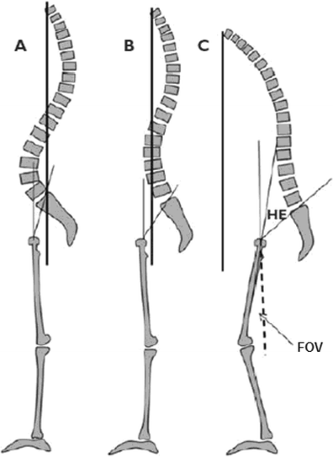
Sagittal Malalignment
Sagittal imbalance observed:
-Age related changes
- Degenerative disorders
-Iatrogenic and posttraumatic
-Genetic or metabolic disease processes
Compensation of spinal imbalance in Degenerative disease:
-loss lumbar lordosis & sagittal imbalance compensated by pelvis retroversion (B)
-Neuromuscular control and pelvis insufficient to compensate sagittal imbalance (C)

Slide 9
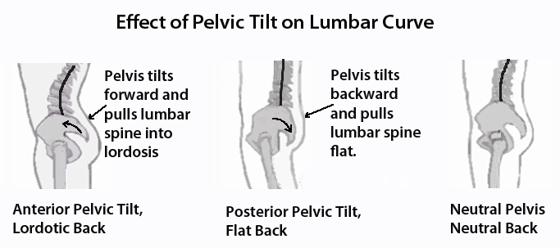
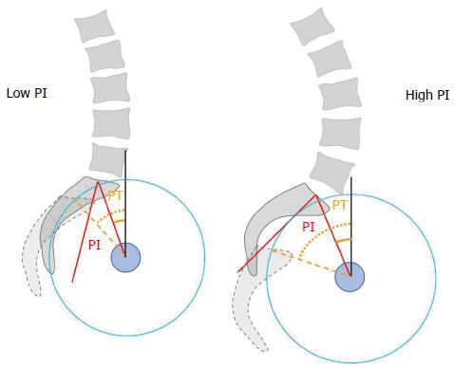
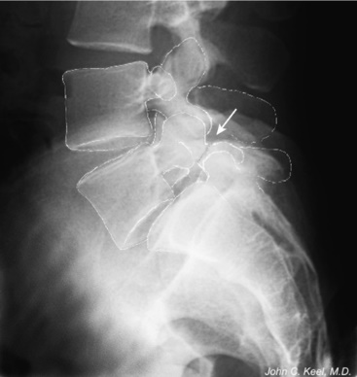
Spinal Curves- Lumbar Pelvic Harmony
Increased pelvic incidence/Tilt:
Sacroiliitis
Trochanteric Bursitis
Discogenic disease
Lumbar Isthmic spondylolisthesis
Pars Defect

Slide 10
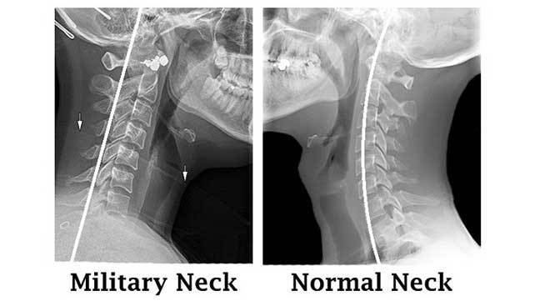
Abnormal Spinal Curves
Military Neck= loss of cervical lordosis/ straightening of neck
Can present:
“normal MRI” but has neck pain
axial neck pain ± radiculopathy
listhesis

Slide 11
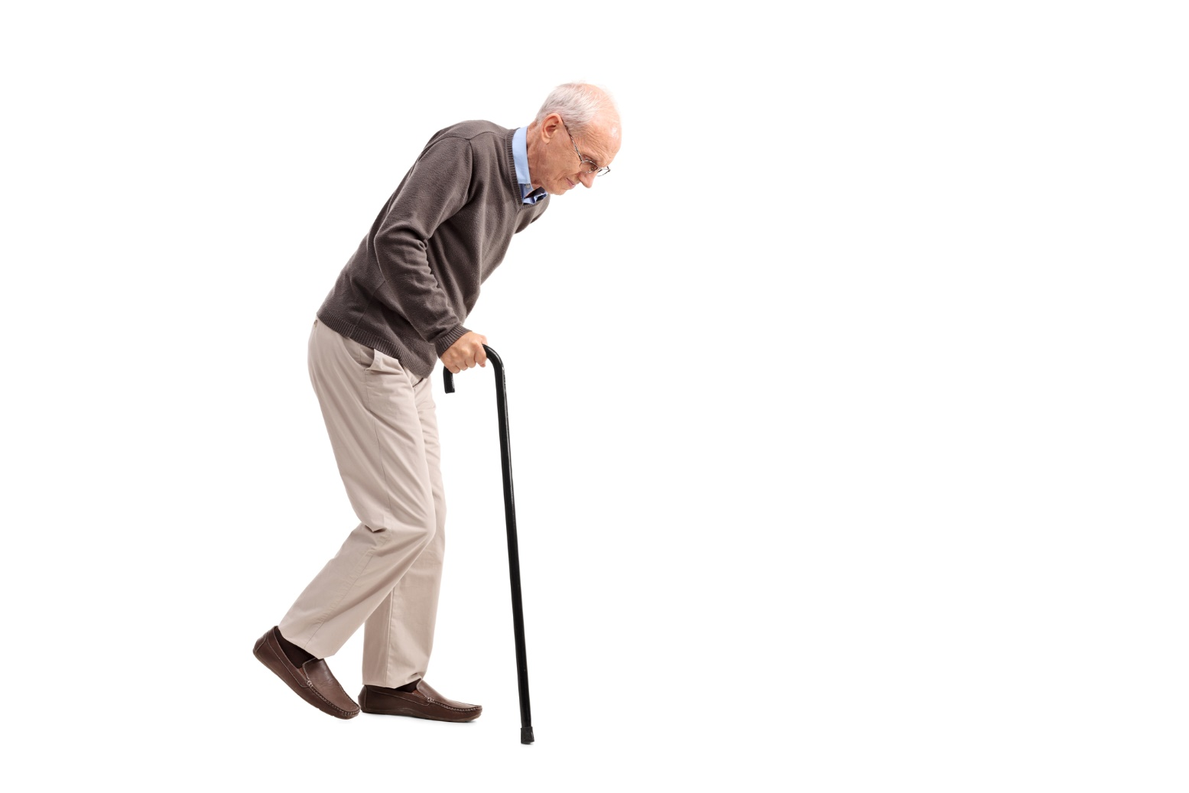
Spinal ImBalance and Falling Risk
Good Balance ≠ Diabetes
Eyesight
Hair Cells
Intact sensation
Increasing SVA = sagittal imbalance
Multiple falls + Anticoagulants/Anti-platelets – Risk > Benefits
Communicate with cardiology –to stop drug and leave on ASA
Outside cone of economy

Slide 12
Neurology
Localize level :
-Muscle /myotome
-Reflex changes
-Dermatomal changes (least reliable)
- Radicular pain – proximal pain and distal numbness
Myelopathy (cervical vs thoracic)- Hoffman's lesion at C6 or above
Symptoms must correlate with Clinical and Radiology findings

Slide 13
Back Pain
Very prevalent – 85%
Commonest cause –disability < 45 years
Bed rest beyond 4 days not advised
85% no specific cause (1% nerve root symptoms , 1-3% lumbar disc herniation's)
90% improve -1 month (including disc herniation's) even with no treatment
Best treated with non-narcotic and spinal manipulation

Slide 14
Back Pain - Etiology
Degeneration (disc bulging/herniation; listhesis, pars defect, stenosis)
Fractures (traumatic/ osteoporosis)
Infections and Tumor
Sacroiliac joint dysfunction
Muscle and ligament strain
Malalignment of the spine
Extra-spinal – Uro-Gyn, AAA,

Slide 15
Back Pain -2 History
Location
Type of pain (sharp/dull) vs. Throbbing/burning (nerve pain –DRG compression (Foraminal/Extraforaminal disc herniation)/nerve damage
Radiation of pain
- groin (T12/L1, L1/2, L2/3)
-thigh to knee (L2/3)
-medial malleolus/ankle (L4)
-Dorsum foot/big toe (EHL) (L5)
-lateral foot /sole/calf (S1)
Aggravated by any movement (mechanical pain)
Night pain - spinal tumor
Spinal claudication – “cart sign”
Switching buttock weight ---SIJ pathology
Back ------back and leg pain ---------leg pain only
History of trauma/lifting
Past history –back surgery
Fever with recent epidural shots
IV drug abuser
Cancer history
Chronic steroids
EXTRASPINAL
AAA/ dissecting aneurysm
Retroperitoneal pathology (pancreatitis, renal calculi), prostatitis
Female- menses, Pelvic inflammatory Disease, ovarian cyst, pyelonephritis, pregnancy (normal & ectopic )

Slide 16
Back Pain - Clinical Examination
Inspection-soft tissue trauma/gibbous
Trigger points- myofascial pain (affects the fascia over the muscle)
Point tenderness-fracture
Excruciating back pain
Nerve root tension signs (SLR /Laseques)
-Sciatica – Sciatic nerve (L4/5/S1-3)
-Reverse SLR –upper lumbar disc herniation's (L1/2/3)
-Crossed –SLR - large disc herniation
- “Pseudosciatica” –Hot SIJ –myofascial pain
-Disc herniation with no nerve root tension signs (location –foraminal/extraforaminal)
Reflexes: knee (L3/4) , ankle (S1)

Slide 17
Back Pain – Lumbar disc herniation's /Radiology:
Plain x-ray (not recommended for routine evaluation unless red flag
- Just plain x-rays (AP/Lateral + Flexion /Extension) adequate
MRI – lumbar spine (contrast only if past back surgery)
Provide soft tissue information (discs, spinal cord , nerve roots)
Provides information on tissue outside the spinal column
Non –ionizing, non-invasive
CT /myelogram: contraindication to MRI ( spinal implants, dorsal cord, bladder stimulator, old pacemakers

Slide 18
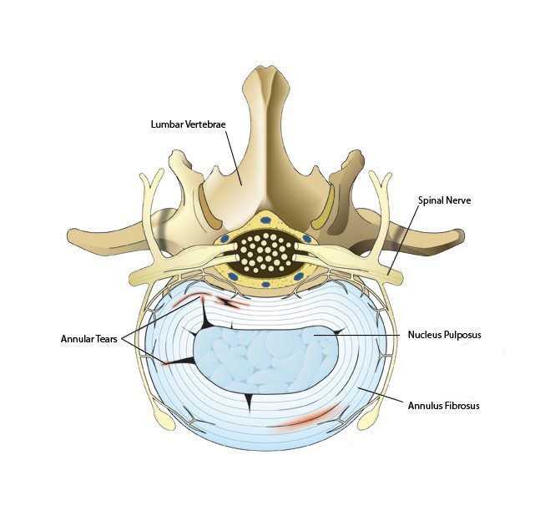
Back Pain – Annular Tears
Anatomy
Annulus fibrosus- poorly innervated (outer edges)
Degenerative disc disease –hyperinnervation /more nerve supply –resulting in discogenic pain
Annular Tears
Tear of the annulus fibrosus (covering of disc)
Usually presents with back pain
Present with leg pain -if gel leaks –leg pain (irritates nerve)
Very painful
May be a prelude to disc herniation

Slide 19
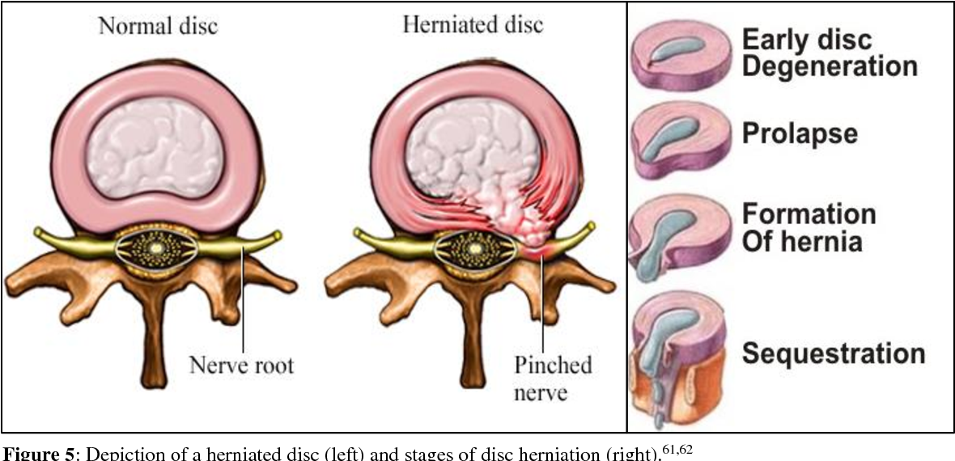
Anatomy of Lumbar Disc herniation
Leg Pain
Back Pain

Slide 20
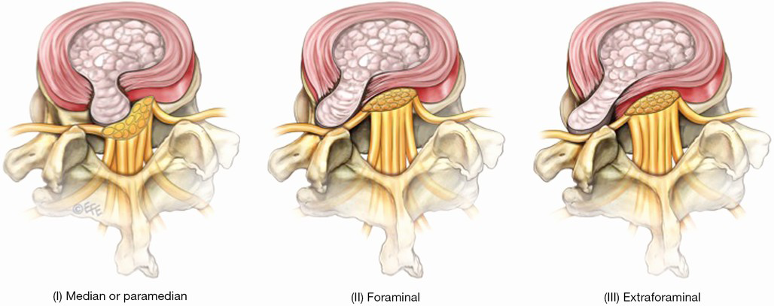
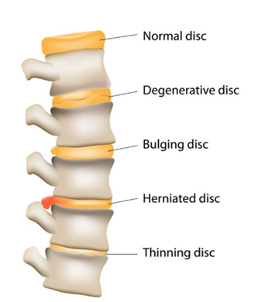
Types of lumbar disc herniation
Key differences between cervical and lumbar:
Pedicle and root exit (cervical above numbered pedicle ; thoracic and lumbar below numbered pedicle
Horizontal vs. Vertical anatomy
-Cervical –”horizontal exit – same nerve affected with paracentral/foraminal
-Lumbar –paracentral and foraminal/extraforaminal location affects different nerves

Slide 21
Back Pain - Clinical Examination
Syndrome | Level of Lumbar disc herniation
 | L3/4 | L4/5 | L5/S1
Root compressed | L4 (F/EF –L3) | L5 (F/EF-L4) | S1 (F/EF L5)
% disc herniation | 3-10% | 40-50% | 45-50%
Diminished Reflex | Knee jerk | *Medial Hamstring | Ankle
Motor weakness | Knee extension (Quadriceps Femoris) | Ankle DF / big toe Tibialis anterior + EHL | Plantar flexion + big toe Gastrocnemius + EHL
Decreased Sensation | Medial malleolus/medial foot | Dorsum of foot, large toe web | Lateral malleolus + lateral foot
Nerve roots exit below the pedicle of its like numbered vertebra in thoracic and lumbar spine (L3 root –will exit at the L3/4 (below pedicle L3 and above pedicle L4)

Slide 22
Back Pain – Non-operative management
Acute episode of Lumbar radiculopathy
-Short course of bed rest (less than 4 days)
-Medrol dose pack
-NSAIDS/muscle relaxers
-PT
-Pain clinic referral –series of epidural steroid shots

Slide 23
Back Pain – Surgical Management
Failure of non-operative management (6 weeks)
Presents with motor deficit (e.g. Foot drop; EHL weakness)
Cauda Equina Syndrome (motor deficit and sphincter dysfunction)
Prefers quick resolution to problem

Slide 24
Cauda Equina Syndrome vs. Conus Medullaris Syndrome
 | Conus Medullaris lesion | Cauda Equina lesion
Onset | Sudden and bilateral | Gradual and usually unilateral
Spontaneous pain | Uncommon, if present bilateral/symmetric in perineum or thighs | Most prominent symptom, severe , radicular type, in perineum, thigh, legs, bladder
Sensory deficit | Saddle, bilateral –usually symmetric, sensory dissociation (pain and temp) | Saddle, , no sensory disturbance, maybe unilateral /asymmetric
Motor deficit | Symmetric, mark fasciculation's | Asymmetric,
Autonomic Symptoms | Prominent –early | late
Reflexes | Preserve Knee and depressed ankle | Knee and ankle may be absent

Slide 25
Differential for Foot drop: Common peroneal nerve vs. L4/5 radiculopathy
Foot drop (ankle DF, EHL +/- inversion ) vs. Flail Foot (all muscles paralyzed distal to the knee with deformity)
Most common cause:
-L4/5 root compression (disc herniation's)-
-crossing legs –usually females (common peroneal nerve)
-Diabetic mononeuropathy
Check foot inversion (posterior tibialis) and internal rotation of flexed hip (Gluteus medius) –spared in common peroneal nerve, involved L4/5 root
EMG/NCV –help with localization
Treatment
-L4/5 root pathology- surgery
-Common peroneal palsy (splint, PT and stop crossing legs)

Slide 26
Spinal Stenosis
Symptoms are usually dynamic / “cart sign”
As a rule – spinal stenosis –does not cause neurologic deficits
Feature | Neurogenic Claudication | Vascular Claudication
Distribution of pain | Distribution of nerve (dermatomal) | Distribution of muscles (sclerotomal)
Sensory Loss | Dermatomal | Stocking distribution
Relief with rest | Slow for pain to stop, stooped posture | Immediate relief, not dependent on posture
Claudication distance | Variable | Usually constant
Discomfort -lifting/bending | Common | Infrequent
Foot Pallor on leg elevation | None | Marked
Peripheral pulses Skin temp | Normal or unilateral reduced Normal | Reduced/absent, femoral bruits common Decreased/dystrophic changes

Slide 27
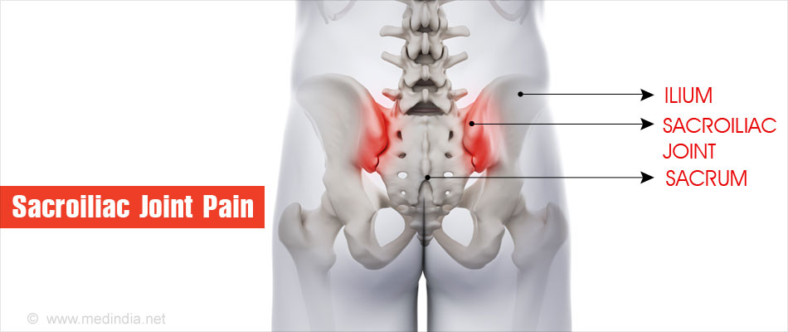
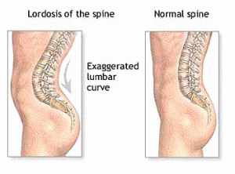
Sacroiliitis
Masquerades as back pain in 15%
History
- switches buttock weight from side to side
-Radiates to leg – “pseudosciatica”-myofascial pain
Diagnosis:
-FABER Test, Distraction Test, palpation of joint-with “pseudosciatica”; may have dermatomal changes only (no reflex or motor deficit)
Treatment:
-Steroid pack, PT, Intra-articular steroid shots, Rhizotomy of S1 and SIJ fusion

Slide 28
Cervical Disc Disease –Clinical Presentation
Radiculopathy – pain/numbness in distribution of root innervation (typical for pain to be proximal and numbness/paresthesia’s-distal
- check motor (lower motor neurons), sensory and reflex changes
Myelopathy- results from compression of the cervical and thoracic spine
-upper motor neuron signs in lower limbs, increased tone (spasticity); sensory level, Hoffman's, pronator catch, Clonus
Myelo-radiculopathy
Nocturnal hand paresthesia's- compressive peripheral nerve compression (carpal or cubital tunnel)

Slide 29
Cervical Disc Disease
Syndrome | Cervical Disc Syndromes
 | C4-5 | C5-6 | C6-7 | C7-T1
% disc herniation's | 2% | 19% | 69% | 10%
Compressed root | C5 | C6 | C7 | C8
Reflex reduced | Biceps | Biceps/Supinator | Triceps | Finger jerk
Motor weakness | Deltoid Shoulder abduction | Elbow Flexion Biceps, Brachioradialis | Wrist extension Triceps | Hand grip Hand intrinsics
Sensory deficit | Shoulder/Deltoid | Arm +thumb/index finger | Arm + Middle/ring finger | Arm /little finger mesial forearm
Nerve roots exit above the pedicle of its like numbered vertebra (7 cervical vertebra and 8 cervical nerves)
C3/4 (C4 radiculopathy) results in axial neck and top of shoulder pain-uncommon

Slide 30
Cervical radiculopathy and Carpal/Cubital Tunnel Syndrome = Double Crush Syndrome
Cervical radiculopathy and median /ulnar nerve compressive neuropathy
Nocturnal paresthesia's
Hand numbness with repetitive activity
Positive Phalens/Tinels
As a rule: always order cervical MRI even if diagnose compressive peripheral nerve neuropathy

Slide 31
Cervicalgia vs. Shoulder Pain-1
Is it a cervical problem ?
- C4/5 nerve roots
Pain on top/in shoulder/between shoulder blades
Is it a shoulder problem? Resulting in neck pain
Tendonitis, bursitis, Rotator cuff injuries, clavicle /scapular #
- Is it a combination?

Slide 32
Cervicalgia vs. Shoulder Pain -2
History:
Location/radiation of pain (shoulder-up to elbow)
Cannot sleep on the shoulder
Usually does not go beyond the shoulder
Clinical Examination
-Biceps Reflex , shoulder abduction
(reduced both pathologies)
-Provocative tests for shoulder:
*Empty Can Test- Rotator cuff /Supraspinatus
*Neer –Hawkins – Subacromial/AC joint impingement
*Lift off Test – Subscapularis - lower border
*Belly Press – subscapularis – upper border

Slide 33
Whiplash Associated Disorders = traumatic injury soft tissues to cervical region (ligaments/muscle/disc/facets joints)
Grade | Description | Evaluation | Treatment
0 | No complaints; No signs | GCS 15/15 , No x-rays or CT scan | ROM exercises
1 | Neck pain, stiffness, tenderness No signs | X-rays, CT scan , MRI | Collar <72 hours, M- relaxers, NSAIDS
2 | Above + reduced ROM, point tenderness |  | Collar < 96 hours, M-Relaxers, NSAIDS
3 | Above + weakness, sensory deficit, absent tendon reflexes | Manages as acute spinal cord injury
4 | Above + fracture or dislocation
WAD is usually a benign condition requiring little treatment and usually resolves in days to few weeks.

Slide 34
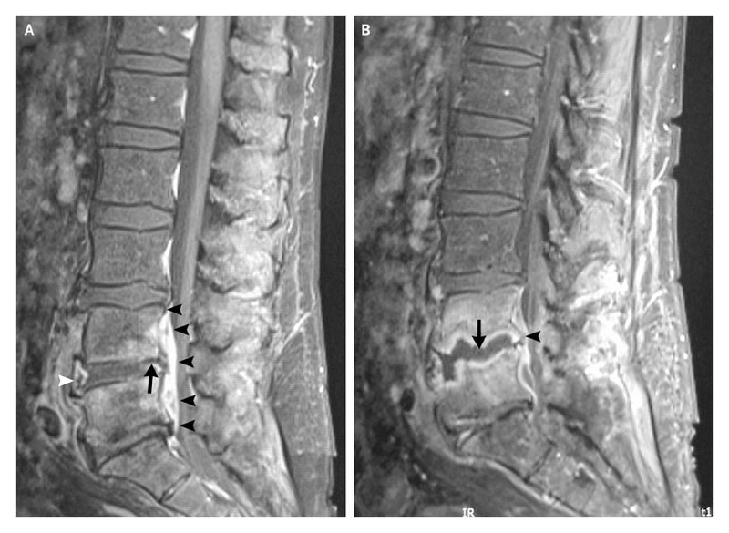
Spinal infections
Presentation: Fever and Back pain
Risk Fx: DM, recent epidural shots, IV drug abuser
Radiculopathy vs. myelopathy vs. combination
High Sed Rate /CRP
Treatment:
non-operative (antibiotics) vs. Surgical decompression/drainage/Fixation + IV antibiotics

Slide 35
Osteoporotic fractures
Majority treated with bracing, pain medication and m-relaxers, PT
some patients may need hospitalization, treatment of osteoporosis
Surgical Treatment: (Vertebroplasty/Kypohoplasty)
Transpedicular injection of methylmethacrylate

Slide 36
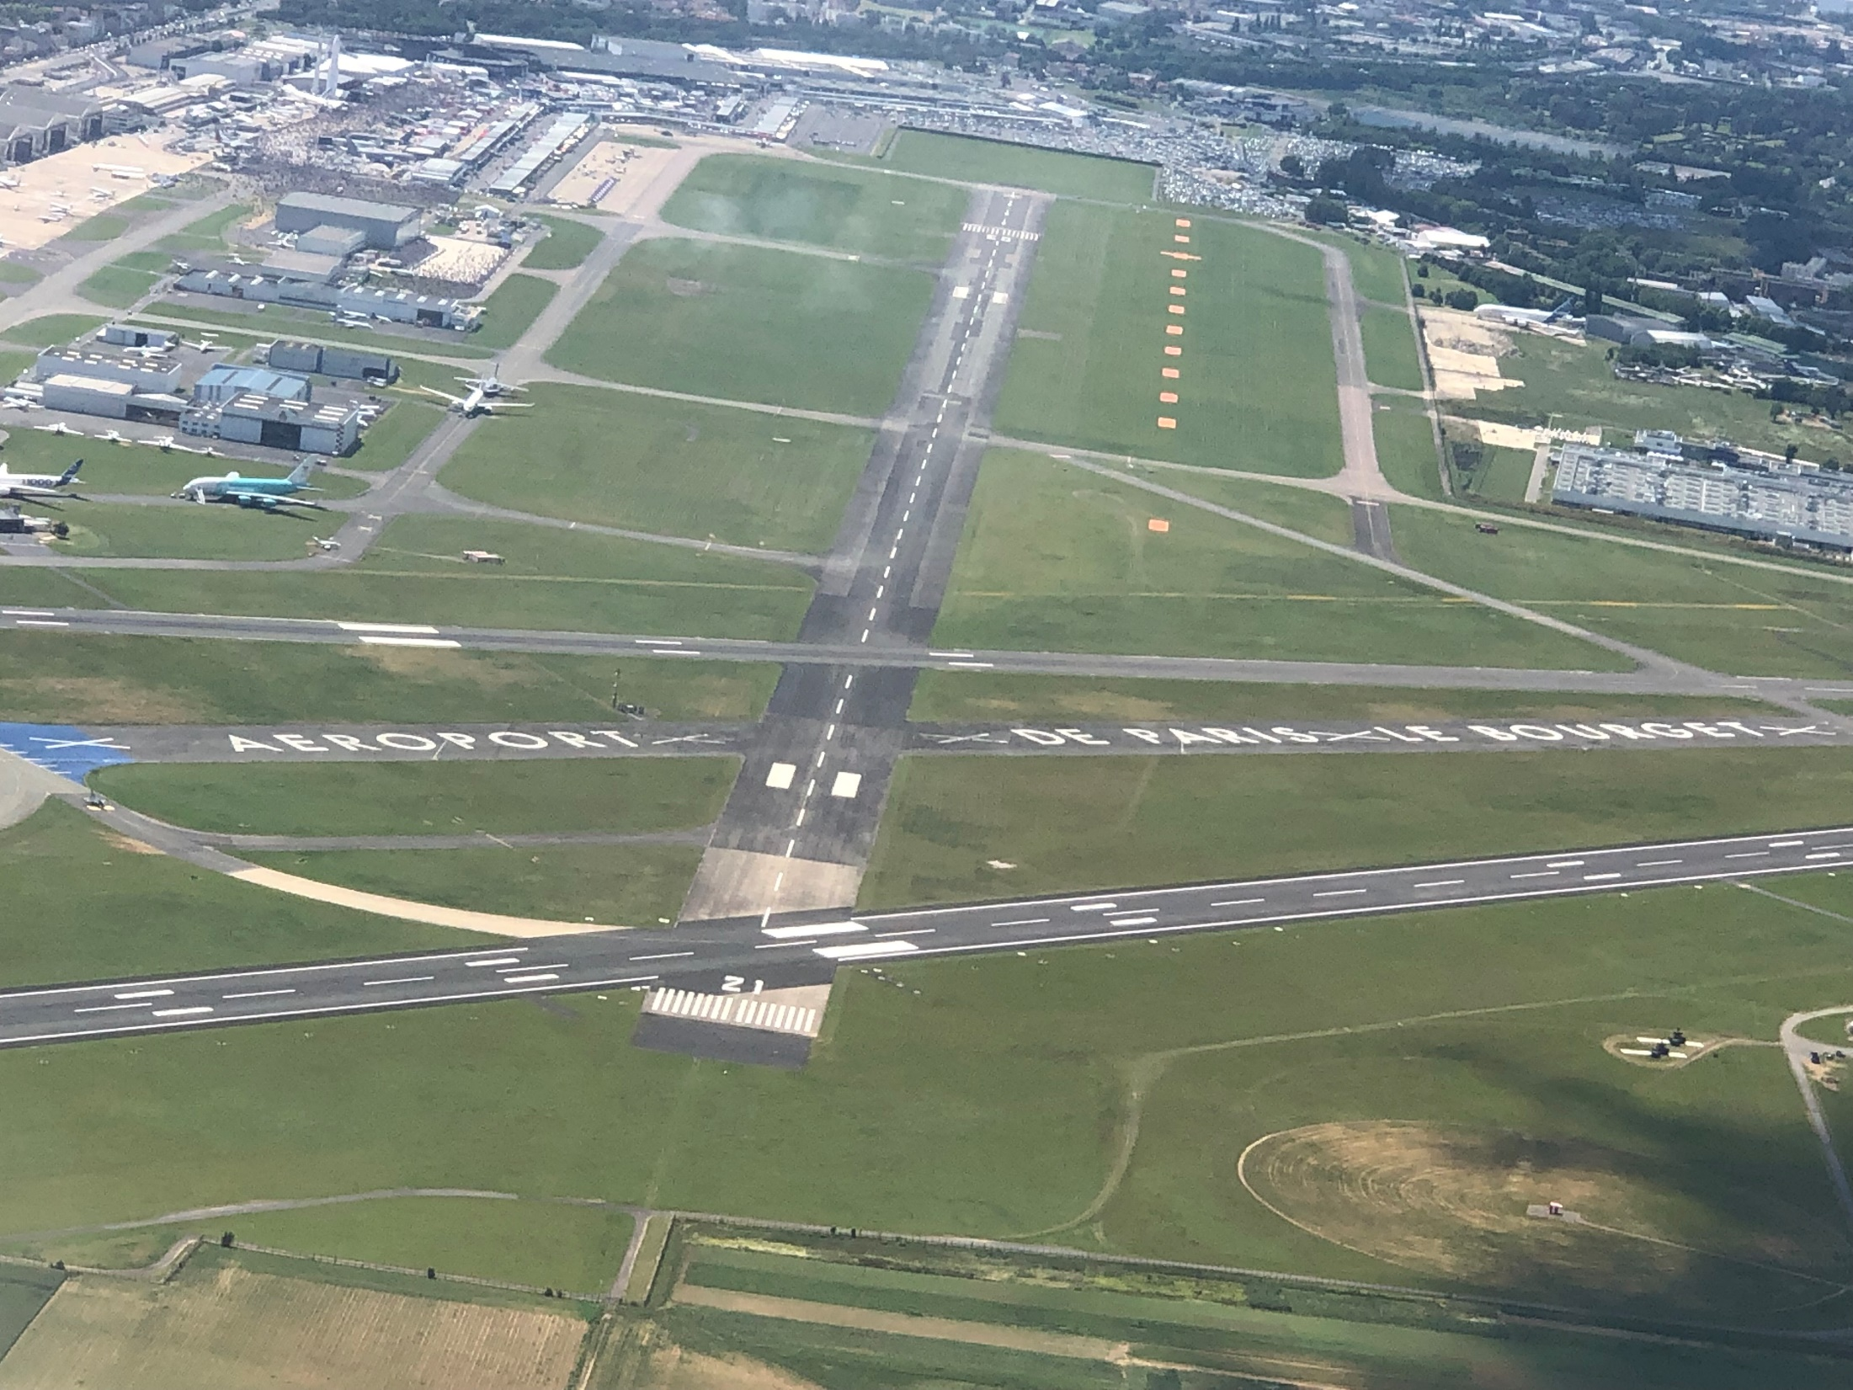
Minimally Invasive Spine Surgery
Computer Assisted Surgery = Image Guidance
Computer Directed Surgery = Robotic Surgery

