Slide 1
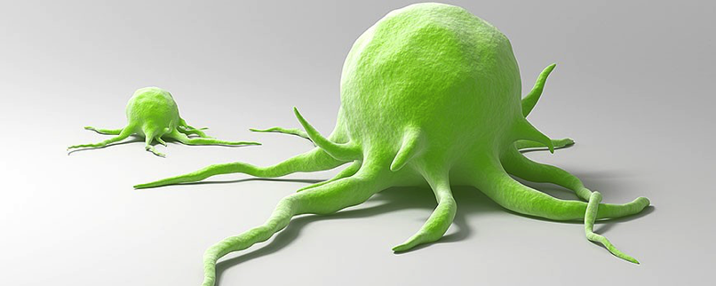
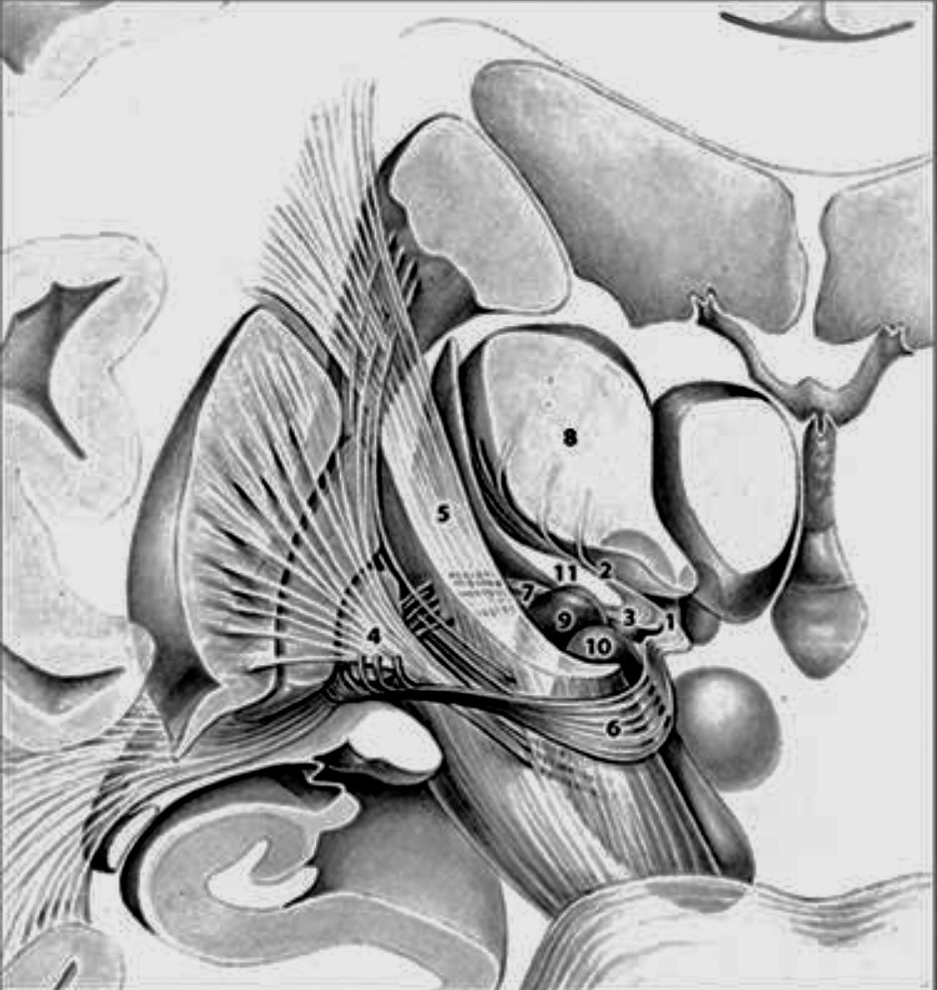
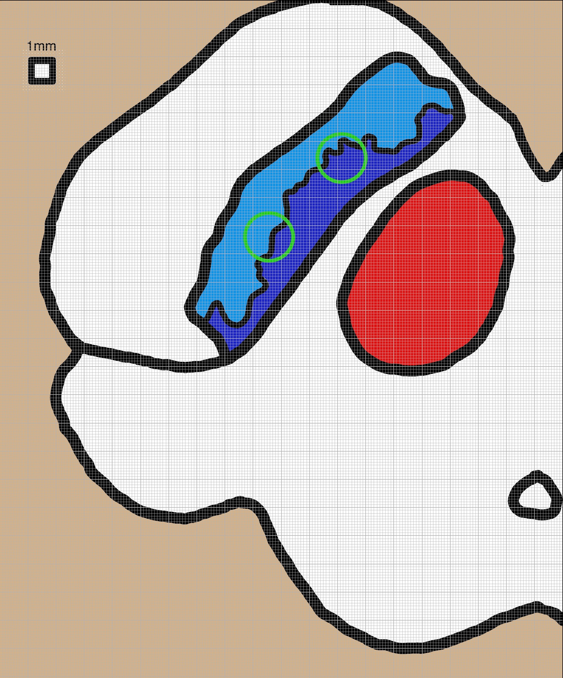
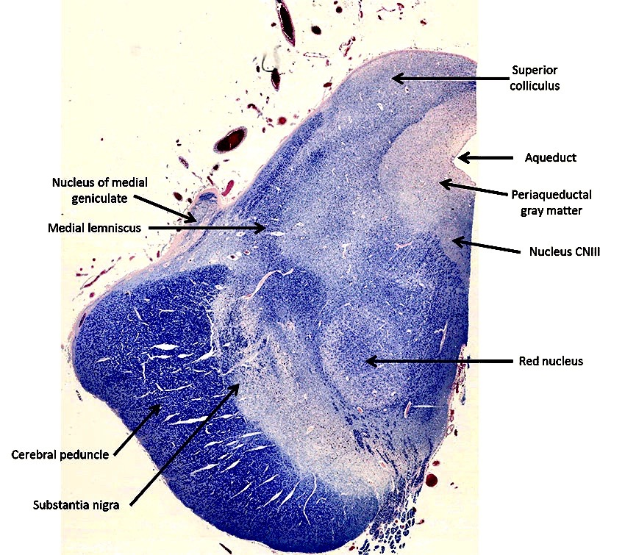
Surgical Management of Movement Disorders and an Update on Parkinson’s Disease
August 23, 2019
Craig van Horne, MD PhD
Professor of Neurosurgery
Clinical Director of the Brain Restoration Center

Slide 2
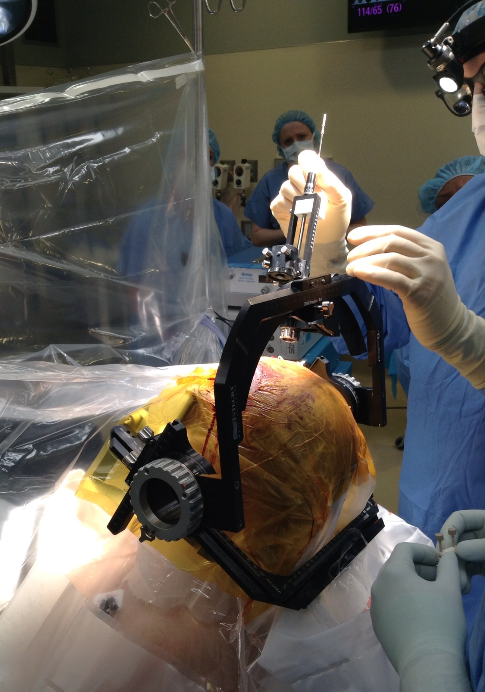
Topics to review
Is surgery really necessary?
Patient selection
Surgical target selection
Operative procedure
Programming
Outcomes

Slide 3
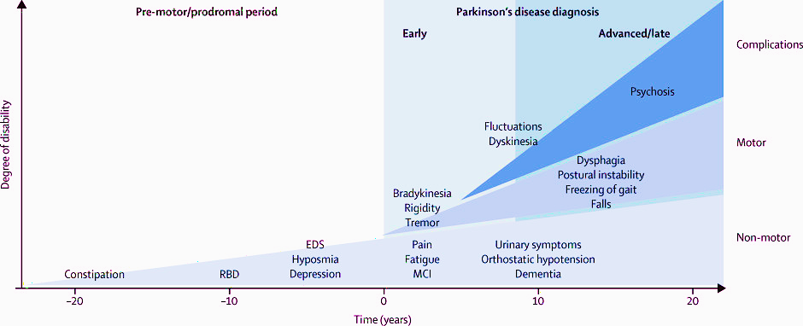
PD Progression Timeline
Prodrome
Early
Advanced
Diagnosis
Complications
Sinemet
Disability
Motor
DBS
Non-motor
Notes:
Parkinson’s disease is a progressive neruodegenerative disorder and although there are treatments that help the symptoms, there are no true PD patients that are in remission. Because the bottom line is that we currently have no therapeutics that slow, halt, or reverse the progression of PD

Slide 4
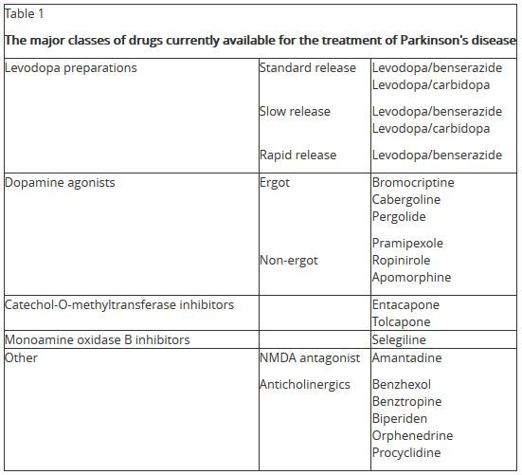

Slide 5
FDA approved therapies to treat disease progression in PD
Drug/Therapy | Dose | Action | Side effects

Slide 6
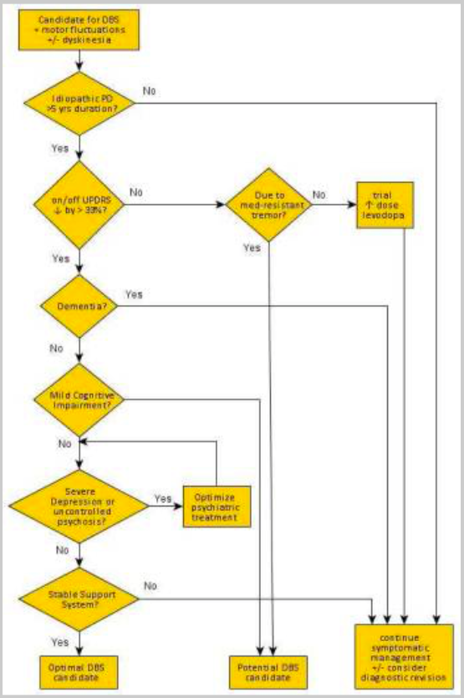
Decision Flow Chart
CAPSIT-PD
Diagnosis
Duration
Sinemet response
Cognition
Mood / psychosis
Yes : Maybe : No
Patient Selection

Slide 7
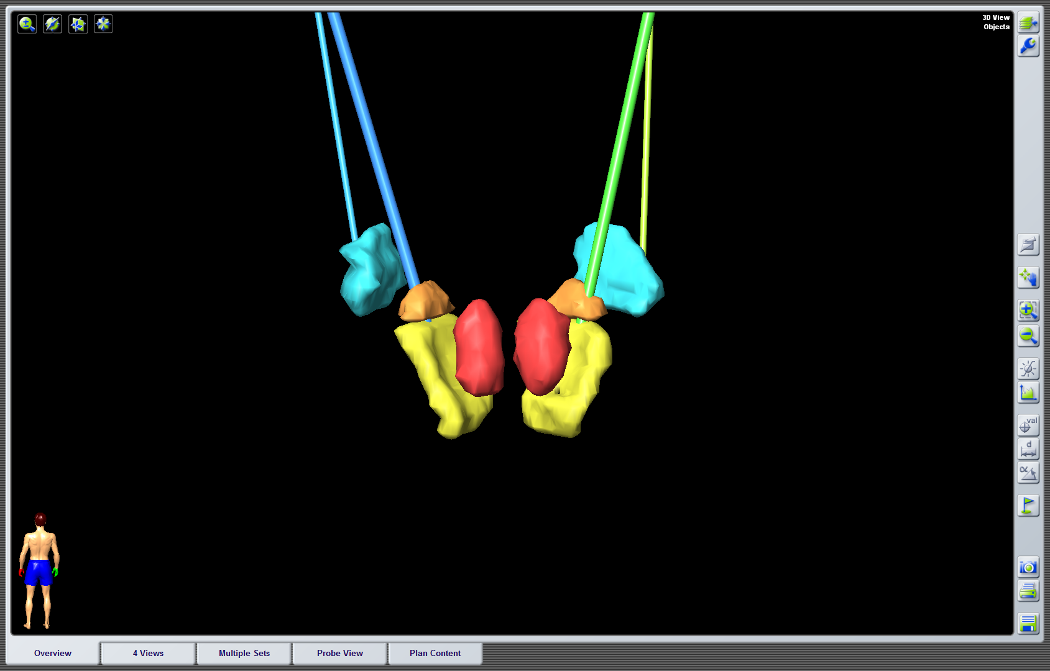
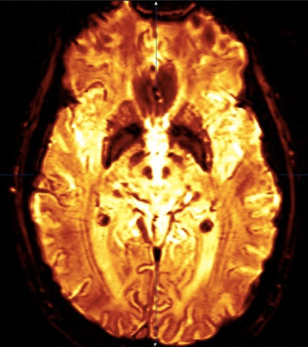
STN vs GPi
Surgical Target

Slide 8
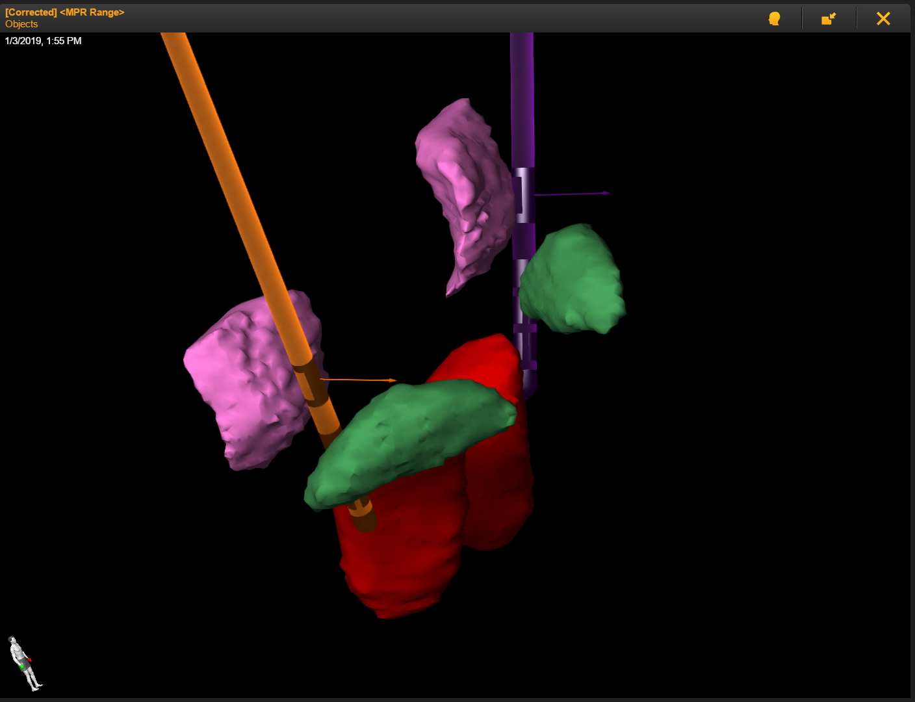
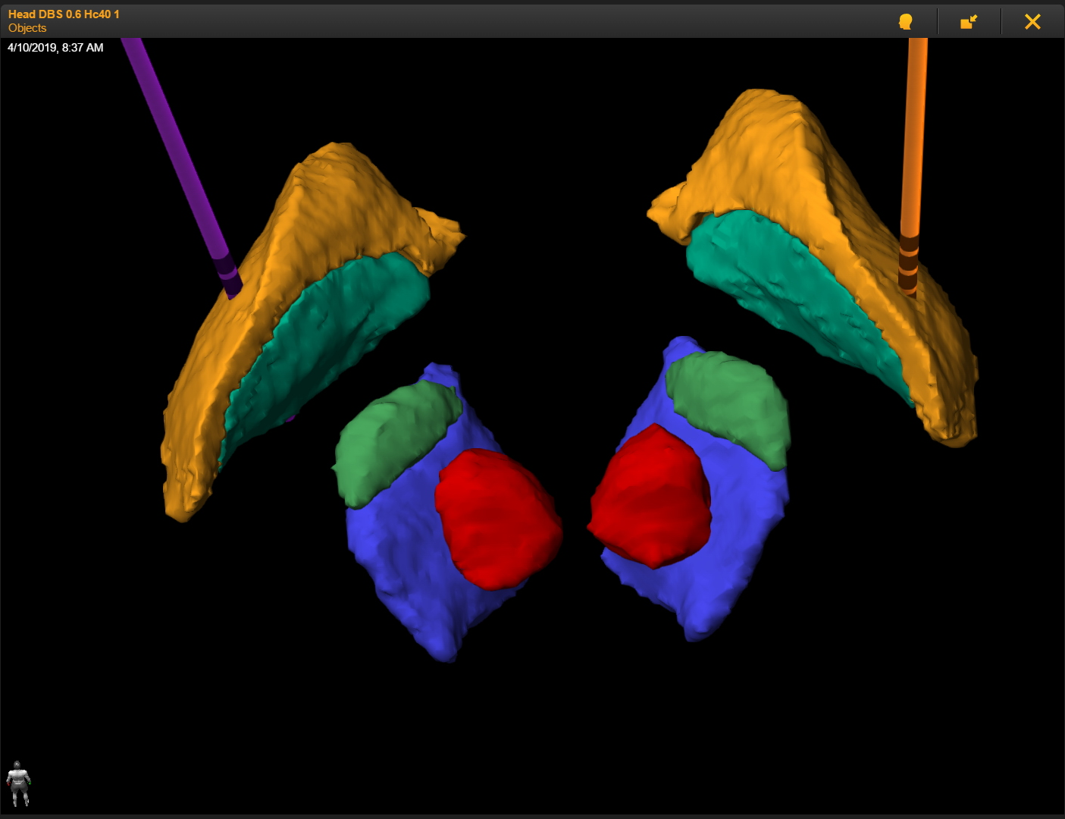
STN GPi
Surgical Target

Slide 9
The Great Debate
STN
GPi
Motor Control
Cognitive risk
Mood risk
Medication reduction
Longer battery life
Motor Control
Cognitive safe
Mood safe
Less medication reduction
Short battery life
Surgical Target

Slide 10
Deep Brain Stimulation
Stimulating Electrode
Lead Extension
Pulse Generator
Surgical Procedure

Slide 11
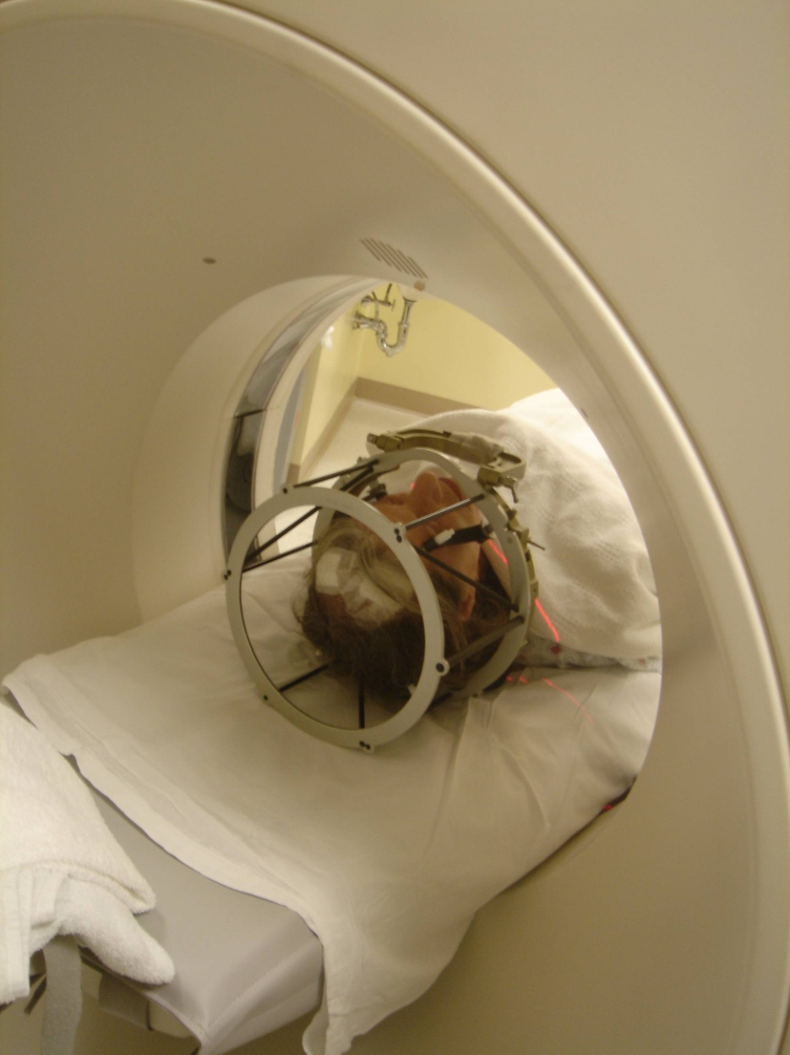
Surgical Procedure

Slide 12
Surgical Procedure

Slide 13
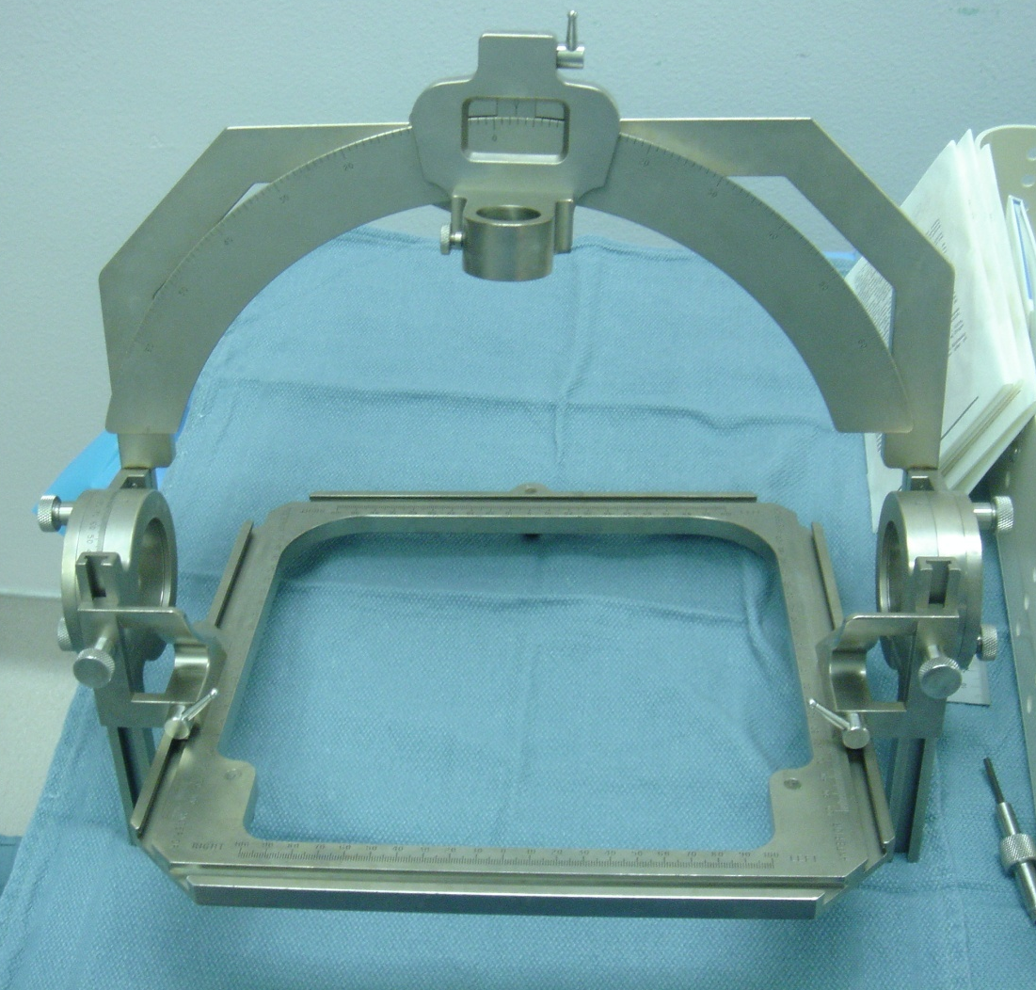
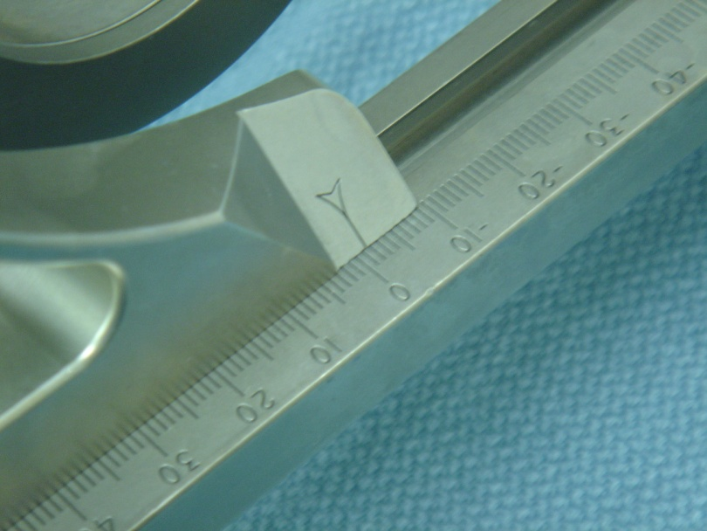
Surgical Procedure

Slide 14
Stimulation Trial
Symptomatic
Improvement
Diplopia
Muscular contraction/
Facial pulling
Paresthesias
Surgical Procedure

Slide 15
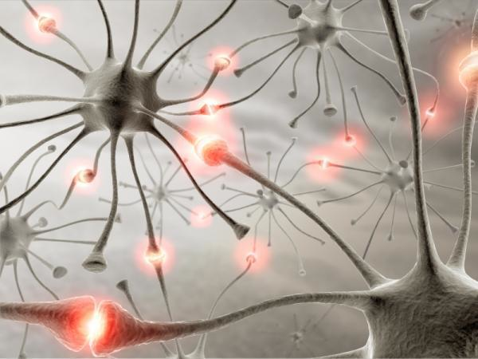
STN
1.5 mm
0
1
2
3
7mm
Programming

Slide 16
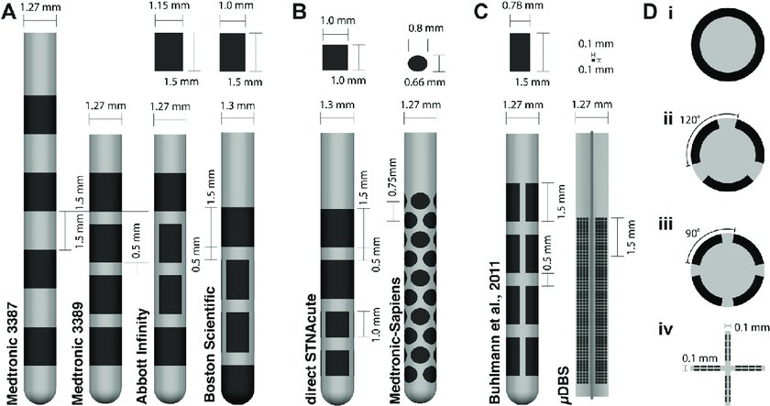
Directional Electrode Designs:
Programming

Slide 17
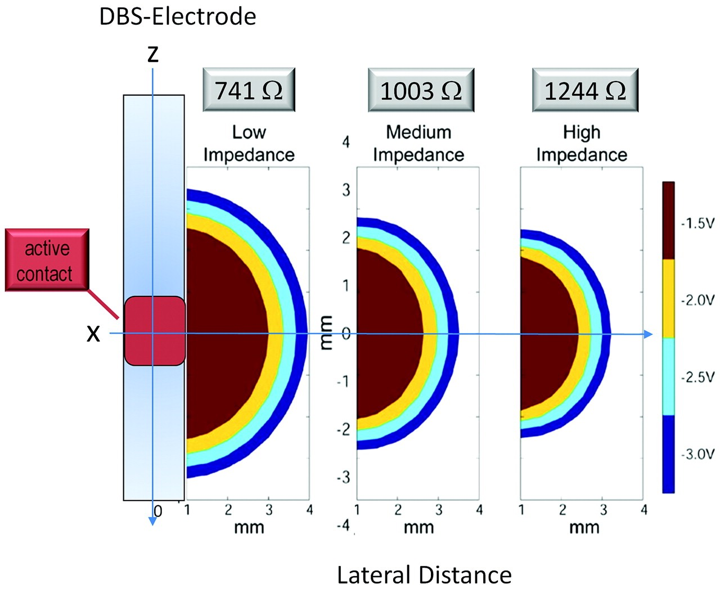
V = I*R
V² * pw * f
E = ------------------ (1s)
R
Programming

Slide 18
Clinical effects of DBS
Positive
Negative
Reduction of Dyskinesia
Decrease in Tremor
Decrease in Bradykinesia
Decrease in Rigidity
Gait improvement (+/-)
Medication reduction
Risk of surgery
Indwelling hardware
Multiple visits
Battery replacements or
Daily recharging
Decrease in verbal fluency
Outcomes

Slide 19
Overall:
25 / 60 / 15
Outcomes

Slide 20
It is all about options
Surgical decision making:
What surgical options are appropriate for the patient?
What does the patient decide to do?

Slide 21
Initial Workup:
A good history
Tremor scoring
MRI
Surgical assessment
Non-surgical treatment options
Surgical treatment options

Slide 22
What are the patient’s options to choose from?
No surgery
Let me think about it.
Not now. Wait and see.
Let’s do this

Slide 23
What is deep brain stimulation?

Slide 24
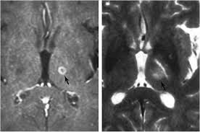
What are the alternatives?
Thalamotomy

Slide 25
What are the benefits?
FDA approved for tremor in 1997
Significant reduction in tremor
Increased quality of life

Slide 26
What are the risks?
Hemorrhage / Stroke
Infection
Hardware malfunction
Stimulation side effects and limited therapeutic response
Need for battery replacements

Slide 27
Deciding for surgery
Setting expectations
What we tell our patients
What do our patients want to hear
What do the families want to hear

Slide 28
Case presentation
58 year old gentleman
History of Essential Tremor for 15 years
Tremor in upper extremities, right leg, voice
Difficulties with writing, dressing, eating
Avoids social situations
Medications: Propranalol, primadone, klonopin
Feels like his is getting worse

Slide 29
Patient goals:
Wants to:
1. write
2. eat
3. shave
4. unlock doors

Slide 30
MRI

Slide 31
Targeting
Notes:
Summary of observed or measured phenomena derived from multiple neuroimaging modalities, neuropsychological testing, and postmortem examination (indicated by differently colored symbols). The location of neuroimaging results was projected onto tomographic anatomic images of the brain acquired during the sectioning process7: Purkinje cell loss,25 presence of Lewy bodies,25,27 reduced fractional anisotropy,40,41,46 placing of deep brain stimulation electrode,18 GM loss,32,34,35 increased blood flow,8,47,48,49 WM loss,34 increased ADC,44 increased mean diffusivity,40,41,42 increased axial diffusivity,42 reduced NAA/total creatine.52 Bs indicates brain stem; Cd*, caudate; Cb*, cerebellum; cc*, corpus callosum; dl PFC, dorsolateral prefrontal cortex; Dt*, dentate nucleus; ec*, external capsule; FL*, frontal lobes; GP*, globus pallidus; icp*, inferior cerebellar peduncle; Ins*, insula; ic*, internal capsule; IPL*, inferior parietal cortex; LF-WM, lateral frontal WM; (L) PL-WM, (left) parietal WM; Md*, medulla; MFG, medial frontal gyrus; MTG*, middle temporal gyrus; OL*, occipital lobes; OF-WM, orbitofrontal WM; PL-WM, parietal WM; Pons*, pons; R*, red nucleus; R FP-WM, right frontoparietal WM; RLL, right limbic lobe; RR, retrorubal area of midbrain; SmC, sensorimotor cortex, scp*, superior cerebellar peduncle; SN*, substantia nigra; SPL*, superior parietal lobule; Str*, striatum; TL*, temporal WM; Th*, thalamus; VIM, ventral intermediate nucleus of the thalamus; Ver*, vermis. The asterisks denote anatomic abbreviations from Mai et al.54

Slide 32
Targeting
Notes:
Summary of observed or measured phenomena derived from multiple neuroimaging modalities, neuropsychological testing, and postmortem examination (indicated by differently colored symbols). The location of neuroimaging results was projected onto tomographic anatomic images of the brain acquired during the sectioning process7: Purkinje cell loss,25 presence of Lewy bodies,25,27 reduced fractional anisotropy,40,41,46 placing of deep brain stimulation electrode,18 GM loss,32,34,35 increased blood flow,8,47,48,49 WM loss,34 increased ADC,44 increased mean diffusivity,40,41,42 increased axial diffusivity,42 reduced NAA/total creatine.52 Bs indicates brain stem; Cd*, caudate; Cb*, cerebellum; cc*, corpus callosum; dl PFC, dorsolateral prefrontal cortex; Dt*, dentate nucleus; ec*, external capsule; FL*, frontal lobes; GP*, globus pallidus; icp*, inferior cerebellar peduncle; Ins*, insula; ic*, internal capsule; IPL*, inferior parietal cortex; LF-WM, lateral frontal WM; (L) PL-WM, (left) parietal WM; Md*, medulla; MFG, medial frontal gyrus; MTG*, middle temporal gyrus; OL*, occipital lobes; OF-WM, orbitofrontal WM; PL-WM, parietal WM; Pons*, pons; R*, red nucleus; R FP-WM, right frontoparietal WM; RLL, right limbic lobe; RR, retrorubal area of midbrain; SmC, sensorimotor cortex, scp*, superior cerebellar peduncle; SN*, substantia nigra; SPL*, superior parietal lobule; Str*, striatum; TL*, temporal WM; Th*, thalamus; VIM, ventral intermediate nucleus of the thalamus; Ver*, vermis. The asterisks denote anatomic abbreviations from Mai et al.54

Slide 33
Stage I

Slide 34
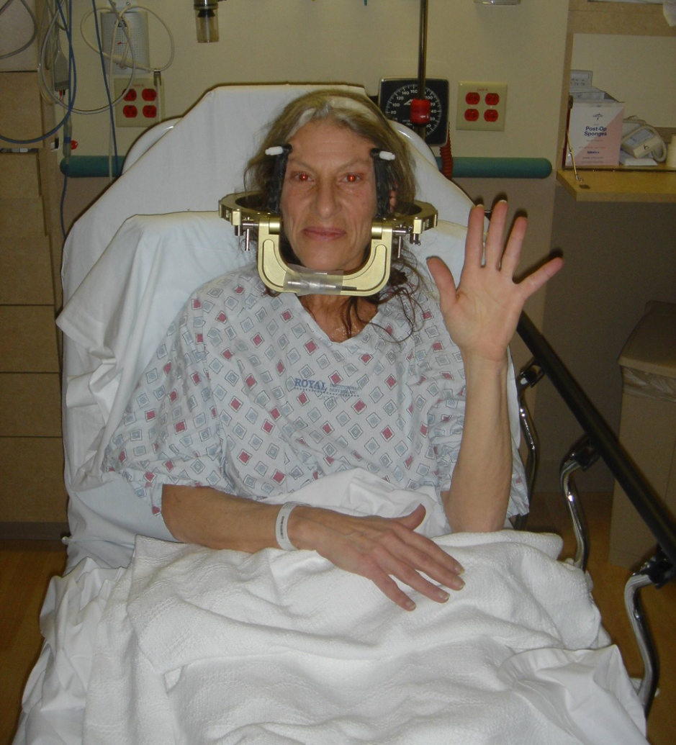
Stage II

Slide 35
Electrode Placement

Slide 36
Post-op care
Stage I
Patients go home several hours after the procedure
Stage II
Patients stay overnight
CT scan post op
Initiate programming in the late afternoon
Re-evaluate in the morning
95% of patients go home day after surgery
Follow-up appointment in 1-2 weeks

Slide 37
Surgical recovery
First post-op visit
Check incisions
Modify DBS settings
Subsequent clinical visits
Modify DBS settings
As frequently as needed

Slide 38
Programming
Identification of best contacts to activate
Represents the location within the brain
Add voltage
Increases the amount of electric current
Add pulse width
Broadens the area of current spread

Slide 39
Video

Slide 40
Summary
The decision for this elective surgery is a very personal one for each patient
Patients typically elect to have surgery because of lack of additional medical options
The surgery is performed in two stages, 3-5 days apart
Results may vary, but typically lead to a substantial increase in the quality of life

Slide 41
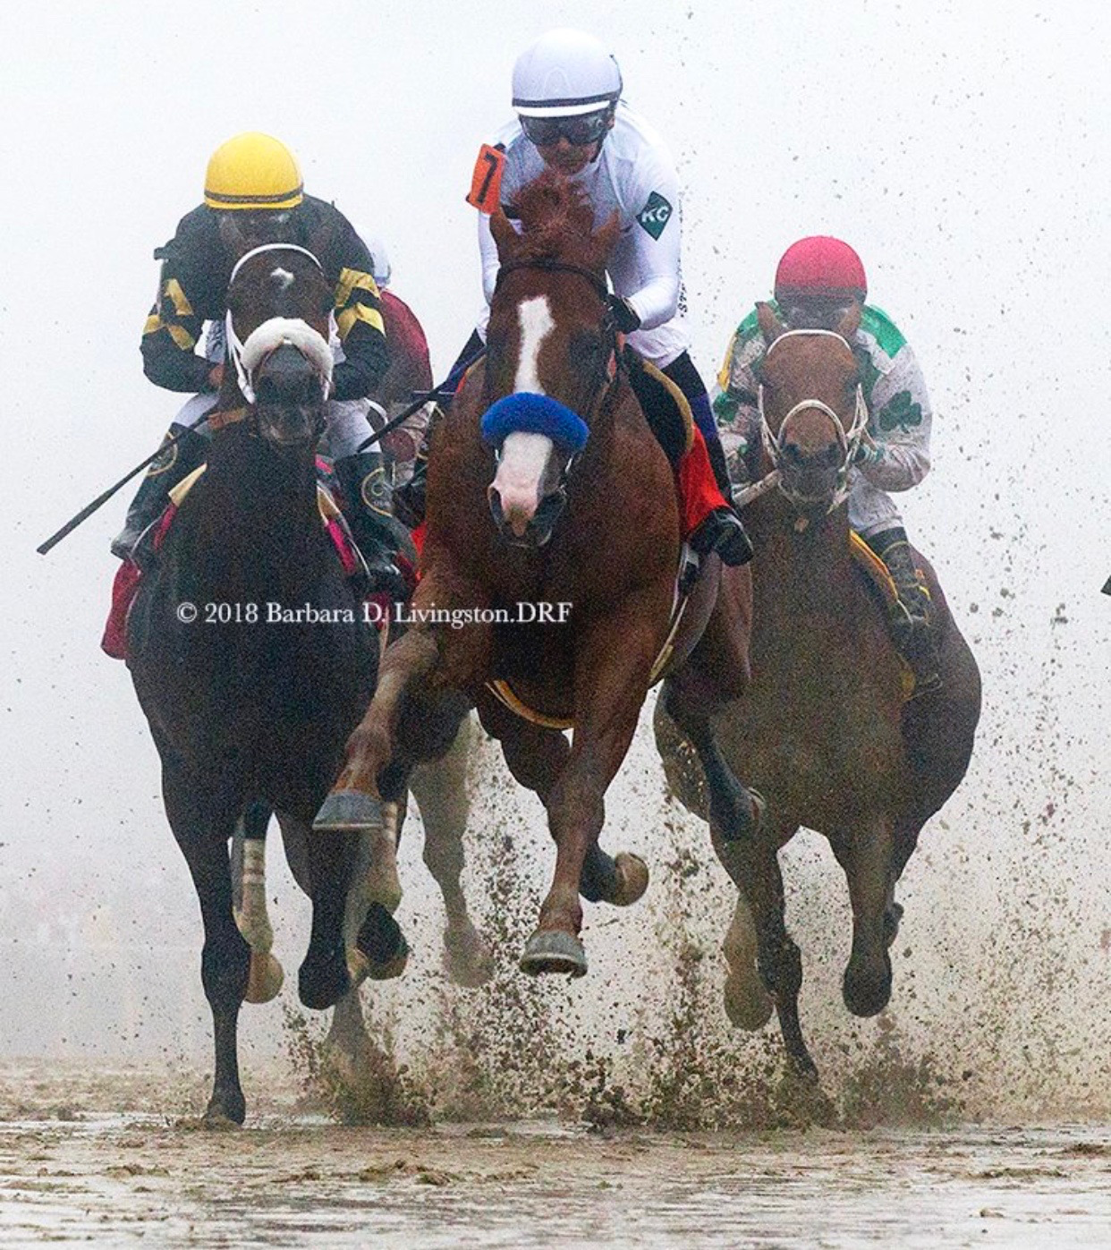
Our Team
PI/Surgery | Voice Assessment
Craig van Horne, MD, PhD | Debra Suiter, PhD
Greg Gerhardt, PhD
Ann Hanley | Tissue Analysis
Rich Lamm, MD | Andrew Welleford
Tripp Hines, MD | Nader El-Seblani
UPDRS Assessment | Coordinators
John Slevin, MD | Morgan Yazell
Tritia Yamasaki, MD | Janet Greene
Julie Gurwell, PA-C, PhD | Renee Wagner, RN, CCRC
Zain Guduru, MD | Stephanie Morris, CCRC
Ashley Guiliani, DNP, APRN | George Quintero, PhD
Neuropsychology Assessment | Special Thanks
Fred Schmidt, MD | Ann Hanley
Lisa Koehl, PhD | Christopher Salmaan

